Slide 1
Mixture of experts
Trelis Research

Slide 2

Why MoE?
A traditional GPT uses all neurons in all matrices for forward passes

Slide 3
Why MoE?
A traditional GPT uses all neurons in all matrices for forward passes

Slide 4
Why MoE?
What if we could split the network + choose the best column of weights to use?
1 2 3 4 5 6 7 8

Slide 5
Why MoE?
What if we could split the network + choose the best column of weights to use?
1 2 3 4 5 6 7 8

Slide 6
How is moe trained? routers
1 2 3 4 5 6 7 8
router

Slide 7
[0,0,0,0,0,0,1,0]
Expert choice
Router Matrix weights
[0.34, 0.35, 0.73, 0.94]
Input vector

Slide 8
training
Output tokens
LOSS = actual - predicted
transformer weights
Back propagation through gpt + router
Router weights
inputs

Slide 9
A problem training Mixture of experts
1 2 3 4 5 6 7 8
One expert can dominate!!!
router

Slide 10
Trick #1
[0,0,0,0,0,0,1,0]
Expert choice
+randomness
Router Matrix weights
[0.34, 0.35, 0.73, 0.94]
Input vector

Slide 11
Trick #2
LOSS = actual - predicted tokens
Penalty for uneven router choice
Output tokens
transformer weights
Back propagation through gpt + router
Router weights
inputs

Slide 12
Is moe useful for laptop inference?
moe
Standard gpt
Notes:
Yes, you get faster inference. But VRAM/RAM is similar.

Slide 13
Does moe reduce costs at scale?
Each expert gets its own gpu and queries are routed and batched
Notes:
Yes, if you route and batch queries.

Slide 14
What are the problems with moe
1 2 3 4 5 6 7 8
Slow to train experts evenly due to noise
router

Slide 15
Fast feed forward - better than moe?
router
router
router

Slide 16
[1] or [0] with probability p
Expert choice
Router Matrix weights
[0.34, 0.35, 0.73, 0.94]
Input vector

Slide 17
Fast feed forward - better than moe?
Binary tree networks allow:
Same training time as gpt
Faster inference

Slide 18
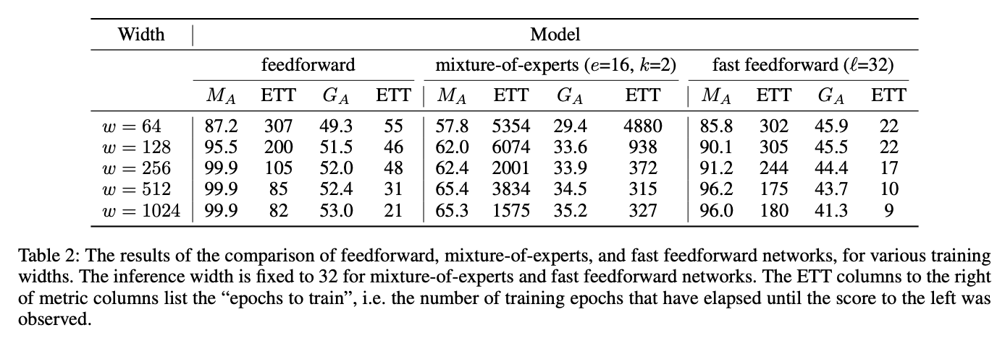
Fast feed forward - better than moe?
ETT = EPOCHES TO TRAIN.M_A=memorisation, G_A=generalisation

Slide 19
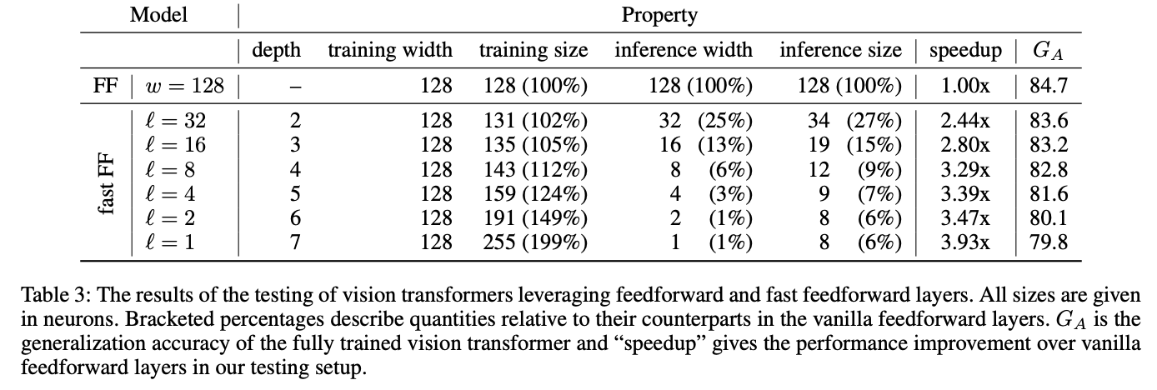
Fast feed forward - inference
CAVEAT - THE ABOVE IS A VERY SMALL NEURAL NET FOR VISION.

Slide 20
WHY does moe (or fff) work?
Standard gpt

Slide 21
WHY does moe (or fff) make sense?
Same model size
Fewer connections
Small accuracy loss
~1/N speed gain
moe/fff

Slide 22
Papers and links
Binary-tree/FFF paper: https://arxiv.org/pdf/2308.14711.pdf
MoE papers: https://arxiv.org/pdf/2208.02813.pdf; https://arxiv.org/pdf/1701.06538.pdf
Reddit thread: https://tinyurl.com/ythsu2nd
Youtube video: https://youtu.be/0U_65fLoTq0
Trelis.com

